Slide 1
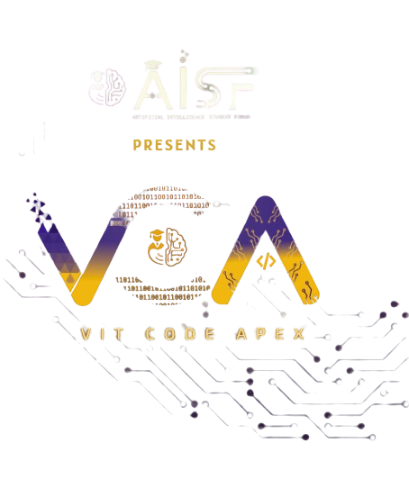

Slide 2

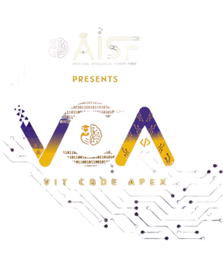
CODE VERSE HACKATHON 2025
Problem Statement Marine fouling, also known as biofouling, refers to the undesirable accumulation of microorganisms, plants, algae, and animals on submerged surfaces. This phenomenon occurs in marine environments and impacts various Indian navy critical structures, particularly ships, offshore platforms, and other submerged infrastructure. Fouling can lead to significant operational and economic problems, including increased drag, reduced speed, higher fuel consumption, and potential introduction of invasive species. Design and develop an end-to-end intelligent image-based solution that can classify the detected fouling species and the density of fouling on the surface.
Team Name Code4Cause
Team Members Tejas , Aryan , Nikhil , Pruthvi
Idea Title:-
OceanEye – Watching Every Move In The Sea

Slide 3
OceanEye
This project proposes an AI-powered image-based system to automatically detect, classify, and estimate the density of marine fouling species on naval vessels and submerged structures. It leverages computer vision and deep learning to provide real-time insights for maintenance and operational planning. By reducing manual intervention and enabling data-driven decision-making, the system ensures improved efficiency, cost savings, and enhanced environmental protection.
Captured underwater images or video feeds (from divers, drones, or ROVs) are processed by the trained model, which classifies fouling species and quantifies density. The results are displayed on a dashboard with alerts, visualizations, and maintenance recommendations.

Slide 4
How It Will Solve the Problem
Automates fouling identification and density measurement, reducing manual inspection and human errors.
Minimizes maintenance costs by enabling data-driven cleaning and repair decisions.
Optimizes dry-docking schedules, ensuring timely and efficient vessel upkeep.
Reduces drag and invasive species risks, lowering fuel consumption and protecting the environment.

Slide 5
FEATURES
Feature 1: Automated Species Classification
How: Deep learning models (e.g., YOLO/ResNet) trained on marine fouling datasets classify microorganisms, algae, barnacles, mussels, etc.
Why: Eliminates reliance on manual inspections, ensuring faster and more accurate detection.
Feature 2: Density Estimation of Fouling
How: Image segmentation and pixel-level analysis measure the percentage of surface covered.
Why: Provides quantitative data to assess severity and schedule timely cleaning.

Slide 6
FEATURES
Feature 3: Real-time Underwater Video Analysis
How: Integration with underwater cameras/ROVs to process live feeds and run AI models directly for instant analysis. Why: Enables on-the-spot condition monitoring without dry-docking, saving time and ensuring continuous operational readiness.
Feature 4: Dashboard & Visualization
How: Interactive web dashboard (Flask/Django + Plotly/Power BI) for classification results, density heatmaps, and trend graphs.
Why: Makes data actionable and accessible for naval engineers and decision-makers.

Slide 7
FEATURES
Feature 5: Alert & Notification System
How: Threshold-based triggers send alerts when density exceeds critical levels.
Why: Prevents late detection that leads to operational inefficiency and high costs.
Feature 6: Historical Data & Trend Analysis
How: Stores inspection results in a database and applies predictive analytics.
Why: Helps plan long-term maintenance schedules and reduces downtime.
Feature 7: Scalability & Adaptability
How: Modular design to support different vessel sizes, offshore rigs, and ports.
Why: Makes the solution versatile across multiple naval and industrial applications.

Slide 8
TECHNICAL APPROACH
Tech Stack (Planned)
4. Tech Stack Used
AI/ML: Python, TensorFlow/PyTorch, YOLOv8/ResNet, OpenCV
Data Storage: PostgreSQL / SQLite
Backend: Flask / FastAPI
Frontend: React / Dash / Power BI for visualization
Deployment: Docker, NVIDIA Jetson (for edge AI), Cloud (AWS/GCP/Azure optional)
Hardware: Underwater cameras, drones, ROVs

Slide 9
FEASIBILITY AND VIABILITY
Feasibility
Technically feasible with existing underwater imaging and AI models. Dataset collection can be done via collaborations with navy/marine research institutions. Edge AI makes real-time deployment practical.
Economically viable as it reduces fuel costs, dry-docking frequency, and invasive species risks. Can be adopted by navy, shipping industry, and offshore oil/gas rigs.
Potential Challenges & Our Plan For the initial phase, our solution will run locally on a laptop to ensure smooth testing and demonstration. While we may not integrate an edge AI device like Raspberry Pi or Jetson right away, our roadmap includes transitioning to such hardware for real-time underwater deployment. This approach allows us to showcase functionality now while paving the way for a scalable, portable, and field-ready system in the future.

Slide 10
IMPACT AND BENEFITS
Expected Impact
Significant reduction in ship drag and fuel consumption through timely fouling detection.
Improved operational readiness of naval vessels with fewer unplanned downtimes.
Contribution to environmental protection by limiting the spread of invasive species.
Key Benefits for Users
Automated, reliable, and faster fouling inspection compared to manual methods.
Cost savings through optimized maintenance and dry-docking schedules.
Actionable insights via dashboards and alerts for better decision-making.
Scalable solution adaptable for navy, commercial shipping, and offshore platforms.
Long-term historical data tracking for predictive maintenance and trend analysis.

